Slide 1

Computing Algorithms Lecture 2: Fundamentals of the Analysis of Algorithm Efficiency part 1
By: Dr. Mohamed Moheeb

Slide 2
Agenda
The Analysis Framework
Asymptotic Notations and basic efficiency Classes

Slide 3

The Analysis Framework

Slide 4
The Analysis Framework
The algorithm is measured using two types of efficiency
Time efficiency (time complexity)
Space efficiency (space complexity)
Note: In the early days of computers, space complexity was a major concern as much as time, but nowadays it is not as large, as hardware capabilities are available.

Slide 5
Input’s size effect on complexity
There is no doubt that the input size influences the time or space complexity of an algorithm.
Example:
Sorting an array of 10 elements will take less time and space than sorting an array of 1000 elements.
Searching for an element in an array of 10 elements will take less time and space than searching in an array of 50 elements.
Since the input size of the algorithm is an important aspect of measuring complexity, this leads to another question: how to measure an input’s size.

Slide 6
Measuring an input’s size
The input size depends on the nature of the algorithm being implemented.
Example :
Finding max in array -> input size is the array size
Matrix multiplication -> is the number of elements in the two matrices
Binary number addition -> number of bits being added
Graph-related algorithm -> is determined by the size of vertices or vertices and edges, if the adjacency list is used.
Therefore, it is logical to investigate an algorithm’s efficiency as a function of some parameter n, indicating the algorithm’s input size

Slide 7
Units for Measuring Running Time
Please give an example of how to measure the algorithm in terms of time.
One obvious way is to use milliseconds or seconds.
One drawback is that the speed of the implementation will depend on how powerful the computer used is

Slide 8
Units for Measuring Running Time
Another way is to count the number of times each of the algorithm’s operations is executed.
This approach is both excessively difficult and usually unnecessary.
The best approach is to count the most important operation of the algorithm with is called the basic operation.
It is not hard to identify that the basic operation of an algorithm is usually the most time-consuming operation in the algorithm’s innermost loop.

Slide 9
Basic operation
The basic operations are arithmetic operations arranged in order of time-consuming:
Division/modules / or %
Multiplication *
Addition +
Subtraction -
Comparison <, >, ==, != , <=, >=

Slide 10

Basic Operation Example 1
for i← 0 to n-1 do
x← x+4
Basic operation: addition
How many times it was executed :
T(n)=$\sum_{i=0}^{n−1}{1=(n−1 −0+1)∗1=}n$
1 basic operation

Slide 11

Basic Operation Example 2
for i← 0 to n-1 do
x← x+4
y← x*4
z← z+2
Basic operation: multiplication
How many times was it executed :
T(n)=$\sum_{i=0}^{n−1}{1=(n−1 −0+1)∗1=}n$
1 basic operations

Slide 12
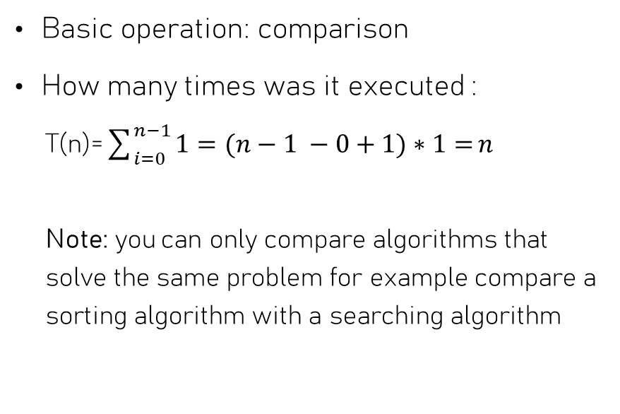
Basic Operation Example 3
Function (A[0….n-1])
for i← 0 to n-1 do
s←0
if A[i] > 15
x← A[i]-2
s← s + A[i]
return s
Basic operation: comparison
How many times was it executed :
T(n)=$\sum_{i=0}^{n−1}{1=(n−1 −0+1)∗1=}n$
Note: you can only compare algorithms that solve the same problem for example compare a sorting algorithm with a searching algorithm
1 basic operation

Slide 13
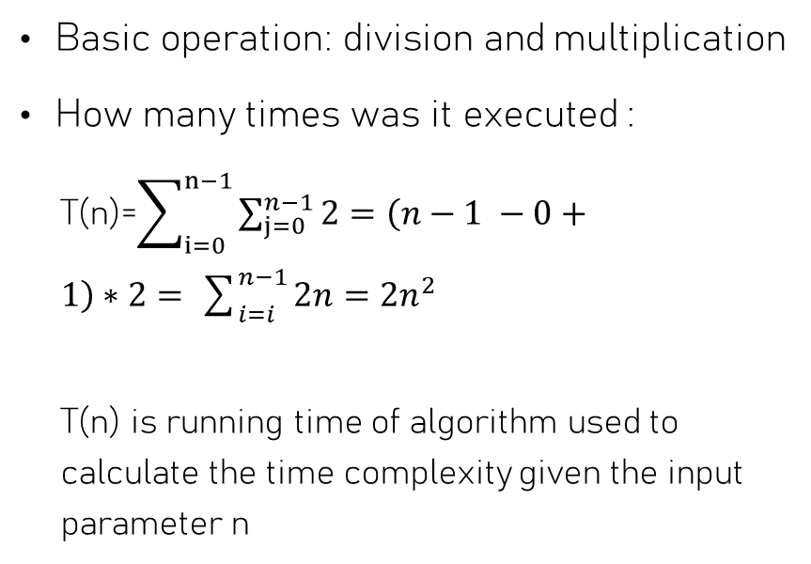
Basic Operation Example 4
for i← 0 to n-1 do
for j← 0 to n-1 do
x← x+1 *2 % 10
Basic operation: division and multiplication
How many times was it executed :
T(n)=$\sum_{i=0}^{n−1}{\sum_{j=0}^{n−1}{2=\left(n−1 −0+1\right)∗2= }}\sum_{i=i}^{n−1}{2n=2n^{2}}$
T(n) is running time of algorithm used to calculate the time complexity given the input parameter n
2 basic operation

Slide 14
Order of Growth
Order of growth describes how an algorithm’s running time increases as the input size n becomes large. (It ignores small details and focuses only on long‑term behavior.)
It ignores constants and lower‑order terms, focusing only on the dominant part of the running time. (Because for large inputs, only the highest‑growing term matters.)

Slide 15
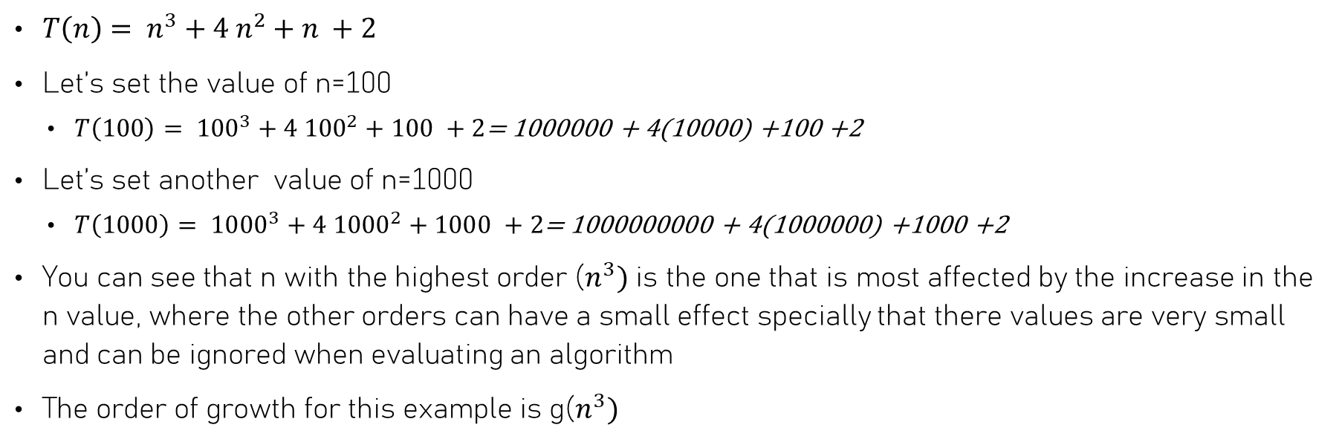
Order of Growth Example
$T\left(n\right)= n^{3}+4 n^{2}+n +2$
Let’s set the value of n=100
$T\left(100\right)= {100}^{3}+4 {100}^{2}+100 +2$= 1000000 + 4(10000) +100 +2
Let’s set another value of n=1000
$T\left(1000\right)= {1000}^{3}+4 {1000}^{2}+1000 +2$= 1000000000 + 4(1000000) +1000 +2
You can see that n with the highest order ($n^{3})$ is the one that is most affected by the increase in the n value, where the other orders can have a small effect specially that there values are very small and can be ignored when evaluating an algorithm
The order of growth for this example is g($n^{3})$

Slide 16
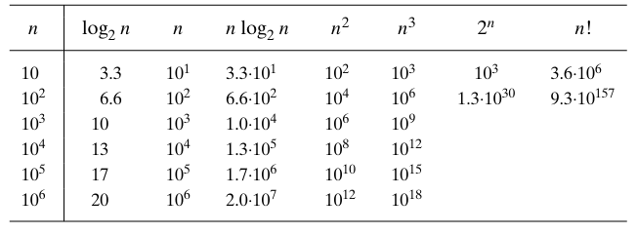
Order of Growth
Book: Introduction to the Design and Analysis of Algorithms

Slide 17
Best, Average, Worst Case
There are many algorithms for which running time depends not only on the input size but also on the specifics of a particular input
example searching algorithm:
Best-case: finding the key from the first search
Worst-case: finding the key in the last element of the array or not finding the key at all.
Average-case: needs to be proven.

Slide 18
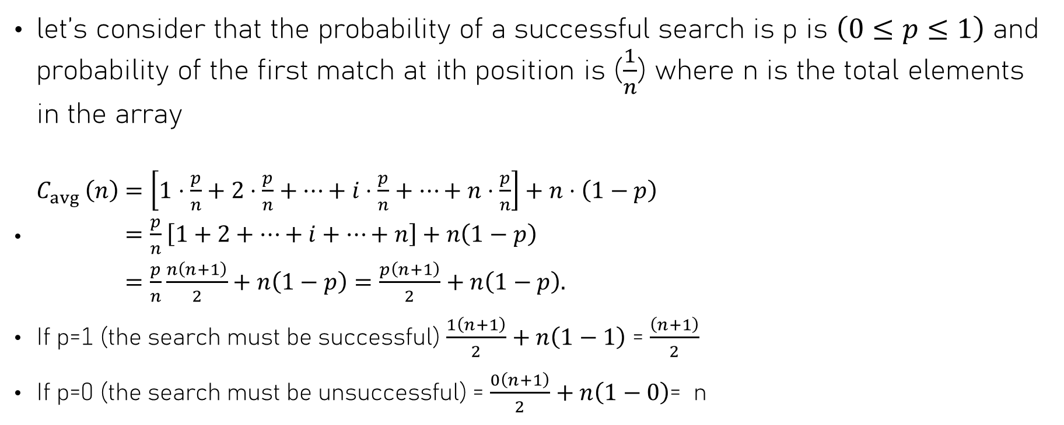
Average-Case
let’s consider that the probability of a successful search is p is $\left(0≤p≤1\right)$ and probability of the first match at ith position is ($\frac{1}{n}$) where n is the total elements in the array
$\begin{aligned}&C_{avg }\left(n\right)&&=\left[1⋅\frac{p}{n}+2⋅\frac{p}{n}+⋯+i⋅\frac{p}{n}+⋯+n⋅\frac{p}{n}\right]+n⋅\left(1−p\right) \\ &&&=\frac{p}{n}\left[1+2+⋯+i+⋯+n\right]+n\left(1−p\right) \\ &&&=\frac{p}{n}\frac{n\left(n+1\right)}{2}+n\left(1−p\right)=\frac{p\left(n+1\right)}{2}+n\left(1−p\right).\end{aligned}$
If p=1 (the search must be successful) $\frac{1\left(n+1\right)}{2}+n\left(1−1\right)$ = $\frac{\left(n+1\right)}{2}$
If p=0 (the search must be unsuccessful) = $\frac{0\left(n+1\right)}{2}+n\left(1−0\right)$= n

Slide 19
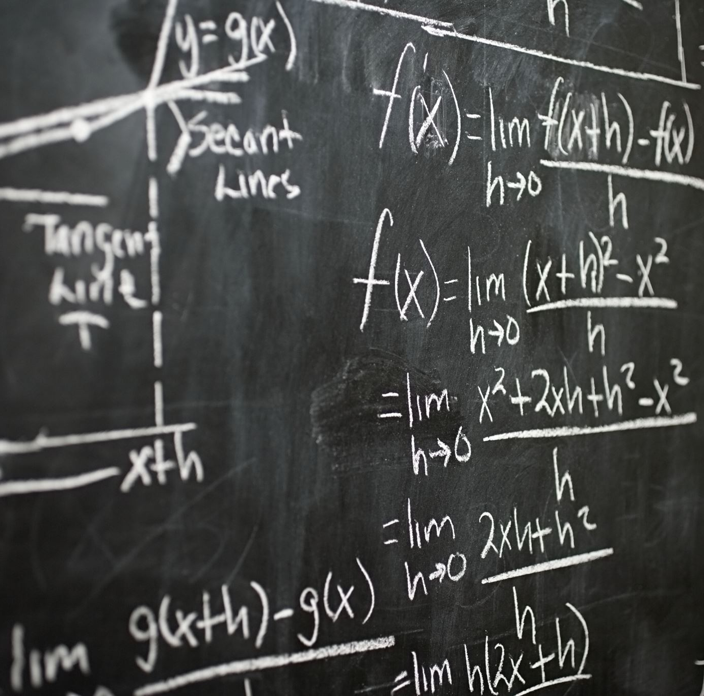
Asymptotic Notations and Basic Efficiency Classes

Slide 20
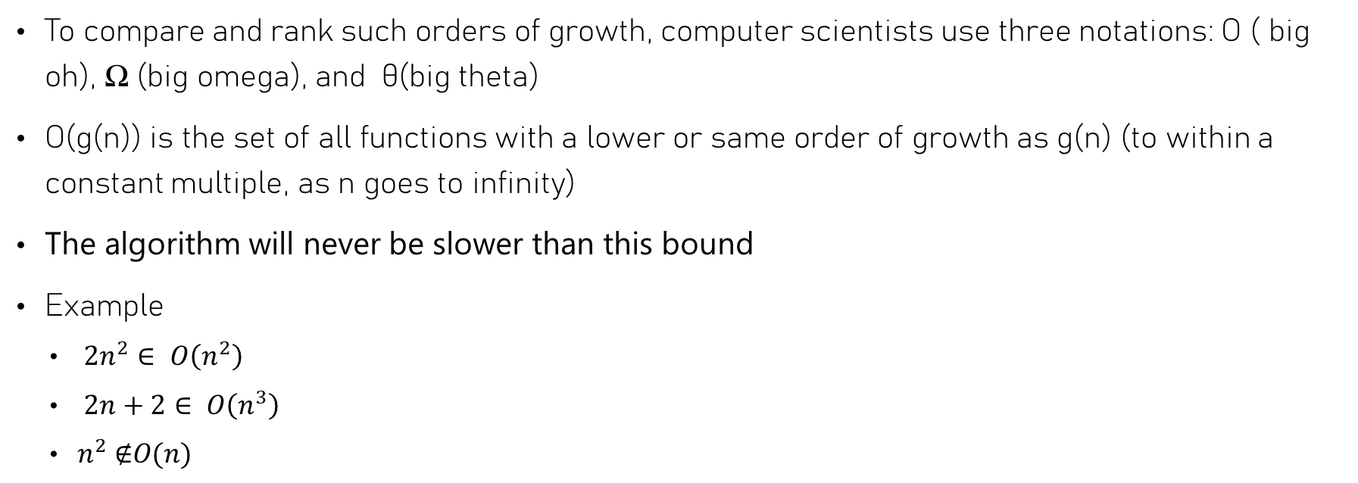
Informal definition
To compare and rank such orders of growth, computer scientists use three notations: O ( big oh), Ω (big omega), and θ(big theta)
O(g(n)) is the set of all functions with a lower or same order of growth as g(n) (to within a constant multiple, as n goes to infinity)
The algorithm will never be slower than this bound
Example
$2n^{2}∈ O\left(n^{2}\right)$
$2n+2∈ O\left(n^{3}\right)$
$n^{2} \text{∉}O(n)$

Slide 21

Informal definition
Ω (g(n)) stands for the set of all functions with a higher or the same order of growth as g(n) (within a constant multiple, as n goes to infinity)
The algorithm will never be faster than this bound
Example
$2n \text{∉} \text{Ω}\left(n^{2}\right)$
$2n+\text{2}∈\text{Ω}\left(n\right)$
$n^{2} ∈\text{Ω}\text{(}n)$

Slide 22
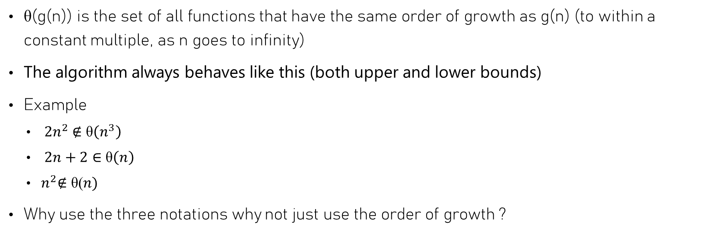
Informal definition
θ(g(n)) is the set of all functions that have the same order of growth as g(n) (to within a constant multiple, as n goes to infinity)
The algorithm always behaves like this (both upper and lower bounds)
Example
$2n^{2} \text{∉} \text{θ}\left(n^{3}\right)$
$2n+\text{2}∈\text{θ}\left(n\right)$
$n^{2}\text{∉} \text{θ}\text{(}n)$
Why use the three notations why not just use the order of growth ?

Slide 23
Formal definition
Asymptotic (change through time) notation analysis focuses on the essential, large‑scale behavior, not the exact small‑scale details.
O(n) → asymptotically linear
O(n²) → asymptotically quadratic
O(log n) → asymptotically logarithmic

Slide 24
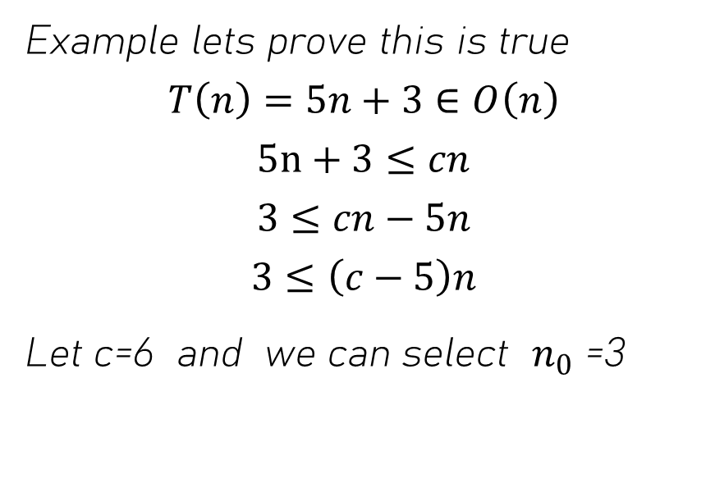
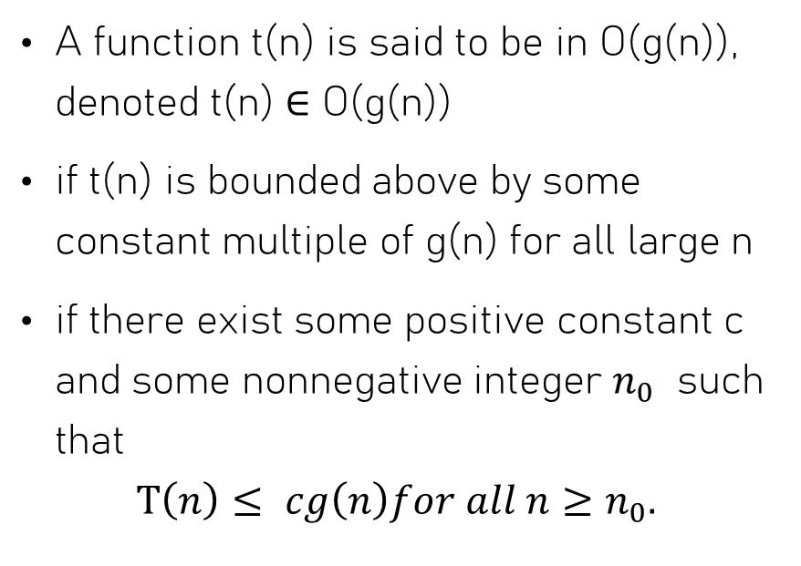
Big O
A function t(n) is said to be in O(g(n)), denoted t(n) ∈ O(g(n))
if t(n) is bounded above by some constant multiple of g(n) for all large n
if there exist some positive constant c and some nonnegative integer $n_{0}$ such that
$$T\left(n\right)≤ cg\left(n\right)for all n≥n_{0}.$$
Example lets prove this is true
$$T\left(n\right)=5n+3∈O\left(n\right)$$
$$5n+3≤cn$$
$$3≤cn−5n$$
$$3≤\left(c−5\right)n$$
Let c=6 and we can select $n_{0}$ =3

Slide 25
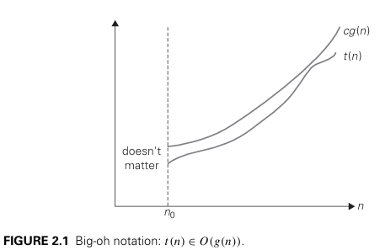
Big O
Book: Introduction to the Design and Analysis of Algorithms

Slide 26

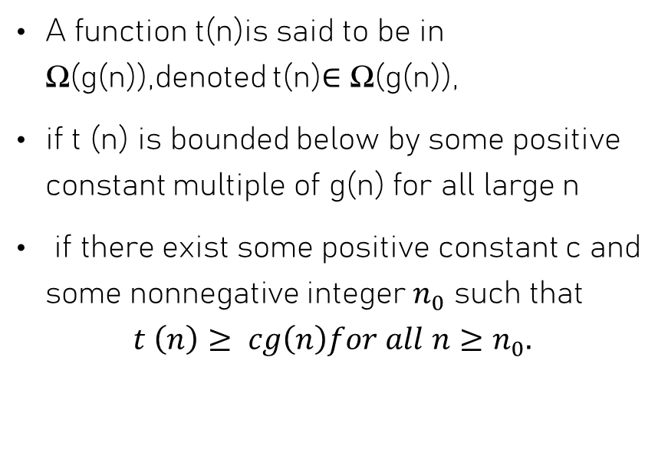
Big Ω
A function t(n)is said to be in Ω(g(n)),denoted t(n)∈ Ω(g(n)),
if t (n) is bounded below by some positive constant multiple of g(n) for all large n
if there exist some positive constant c and some nonnegative integer $n_{0}$ such that
$$t \left(n\right)≥ cg\left(n\right)for all n≥n_{0}.$$
Example lets prove this is true
$$T\left(n\right)=5n^{2}+3∈\text{Ω}\left(n\right)$$
$$5n^{2}+3≥ c n$$
Let select c=1 and $n_{0}=1$

Slide 27
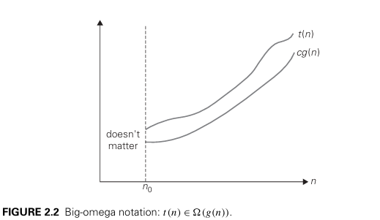
Big Ω
Book: Introduction to the Design and Analysis of Algorithms

Slide 28
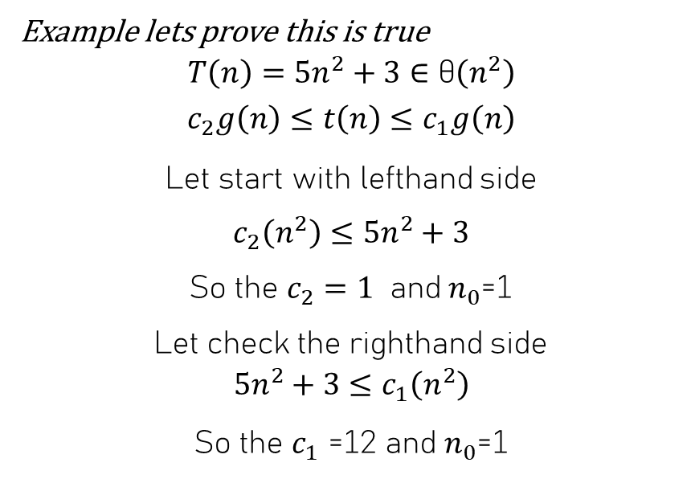
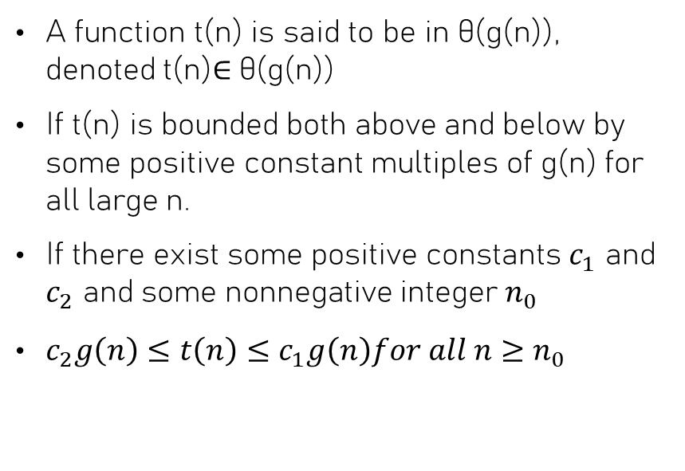
Big θ
A function t(n) is said to be in θ(g(n)), denoted t(n)∈ θ(g(n))
If t(n) is bounded both above and below by some positive constant multiples of g(n) for all large n.
If there exist some positive constants $c_{1}$ and $c_{2}$ and some nonnegative integer $n_{0}$
$c_{2}g\left(n\right)≤t\left(n\right)≤c_{1}g\left(n\right)for all n≥n_{0}$
Example lets prove this is true
$$T\left(n\right)=5n^{2}+3∈\text{θ}\left(n^{2}\right)$$
$$c_{2}g\left(n\right)≤t\left(n\right)≤c_{1}g\left(n\right)$$
Let start with lefthand side
$c_{2}\left(n^{2}\right)≤5n^{2}+3$
So the $c_{2}=1$ and $n_{0}$=1
Let check the righthand side
$$5n^{2}+3≤c_{1}\left(n^{2}\right)$$
So the $c_{1}$ =12 and $n_{0}$=1

Slide 29
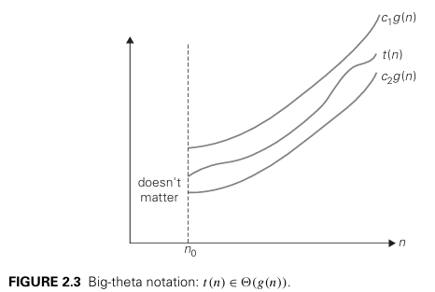
Big θ
Book: Introduction to the Design and Analysis of Algorithms

Slide 30
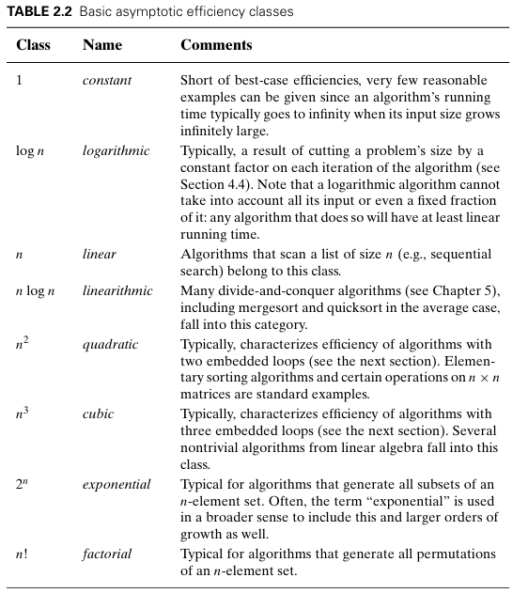
Basic asymptotic efficiency class
Book: Introduction to the Design and Analysis of Algorithms

Slide 31

Example
State if the following notation is true or false:
$n+3∈O\left(n\right)$
$n^{2}+n∈\text{Ω}\left(n\right)$
$n^{2}+3∈\text{θ}\left(n^{2}\right)$
$n^{3}+3∈O\left(n\right)$
$7n^{2}+3∈\text{Ω}\left(n^{3}\right)$
$n^{3}+n∈\text{θ}\left(n^{2}\right)$
$n^{3}+log⁡(n)$ $∈\text{θ}\left(log⁡(n)\right)$
true
true
true
false
false
false
false

